Slide 1

A more detailed introduction to Multi-Armed Bandits for Wireless Communications
Francesc Wilhelmi

Slide 2
Motivation

Slide 3
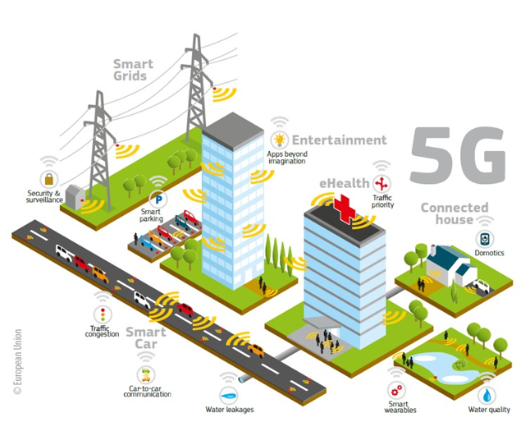
What happened?
New applications (AV/VR, AD, Industry 4.0, etc.)
Strict requirements
eMBB (10-20 Gbps)
uRLLC (< 5ms & 10⁻⁵ packet losses)
mMTC (1,000,000 devices/km²)
Why AI?
Complex world (ensemble of processes)
Lack of models (inaccurate, intractable)
Lots of data
Which kind of AI?
Depends on data handling
Lower layers: short stationarity, sparsity, limited resources to store/process …
Higher layers: misaligned, overwhelming…

Slide 4
Goal of the project
Insights on “Worthiness” of using RL in PHY/MAC
Reliability
Robustness
Efficiency
Focus on Multi-Armed Bandits (exploration-exploitation)
Unavailable or incomplete information (bandit vs expert)
No need of modeling/learning states (added complexity)

Slide 5
Bandits Theory

Slide 6
Introduction

Slide 7



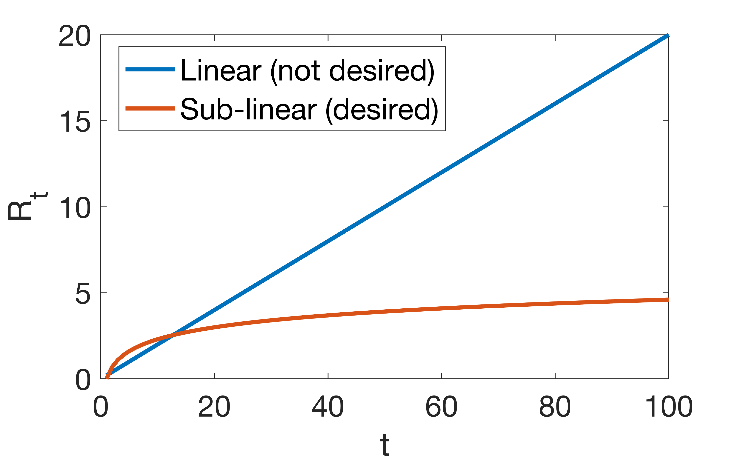

Basics on MABs
Sequential learning framework to address the tradeoff between
Exploitation (maximize long-term reward with current knowledge)
and Exploration (improve your knowledge)
Inspired in Gamblers & Slot machines
Analysis of action-selection strategies based on the expected cumulative regret
anytime, fixed-horizon or asymptotic optimality

Slide 8
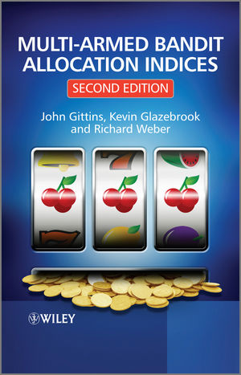
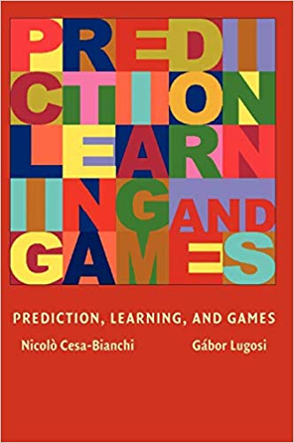
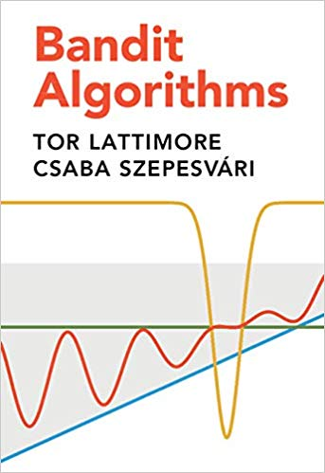
Important References
Baseline:
Thompson, William R. (1933). On the likelihood that one unknown probability exceeds another in view of the evidence of two samples.
Katehakis, M. N., & Veinott Jr, A. F. (1987). The multi-armed bandit problem: decomposition and computation.
Auer, P., Cesa-Bianchi, N., Freund, Y., & Schapire, R. E. (1995). Gambling in a rigged casino: The adversarial multi-armed bandit problem.
Auer, P., Cesa-Bianchi, N., & Fischer, P. (2002). Finite-time analysis of the multiarmed bandit problem.
Gittins, J., Glazebrook, K., & Weber, R. (2011). Multi-armed bandit allocation indices.
Outstanding overviews:
Cesa-Bianchi, Nicolo, and Gábor Lugosi. Prediction, learning, and games.
Bubeck, Sébastien., & Cesa-Bianchi, Nicolo. Regret analysis of stochastic and nonstochastic multi-armed bandit problems.
Slivkins, Aleksandrs. Introduction to multi-armed bandits.
Lattimore, Tor, and Csaba Szepesvári. Bandit algorithms.

Slide 9
Taxonomy

Slide 10
According to the Distribution behind the Reward
Stochastic: bandits with IID rewards
The reward is generated according to a specific stochastic process
Literature: [5]
Guarantees &
Good performance
Non-stochastic (adversarial):
No statistic assumption can be done on the reward generation process
There is no probability distribution (no need to estimate unknown parameters)
Oblivious vs non-oblivious adversaries
Literature: [5, 7]
Weaker guarantees (weak regret) &
Lower performance
Notes:
Worst-case regret: compare rewards with best rewards in each iteration
Weak regret: compare rewards with best fixed arm

Slide 11
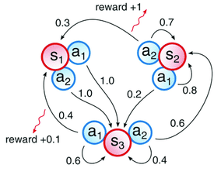
The Markovian case
Stochastic
Markovian
Non-stochastic
Arms associated to state spaces
The state changes according to a given stochastic model (Markov process)
Typically, the number of states and the state transition probabilities are unknown
Sub-types:
Rested: states change when played
Restless [51]: states change regardless of the played action
Image from “Neuromorphic Hardware Learns to Learn”

Slide 12
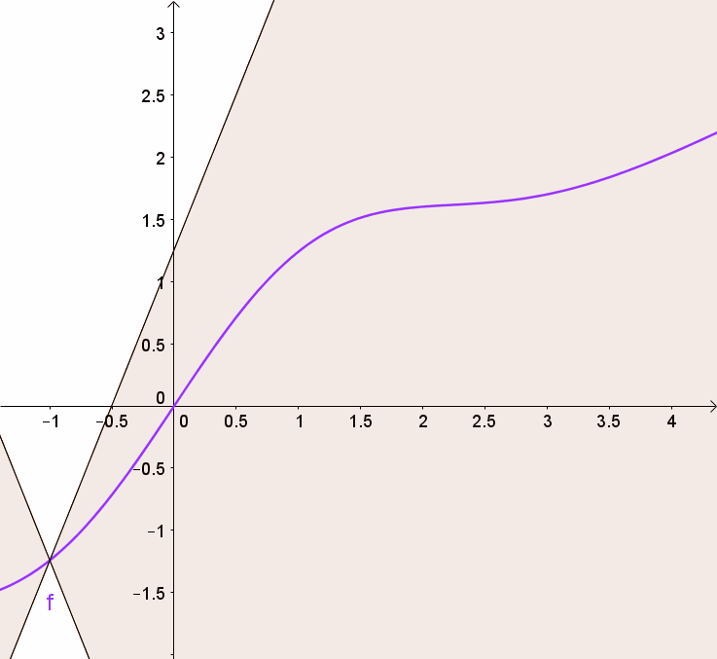
Continuum-Armed Bandits
The set of actions is continuous (infinite)
Bandits are hopeless unless assumptions are done (e.g., Lipschitz condition for the reward) – Similarity between arms
Variants:
Linear
Nonlinear
Some solutions:
Fixed discretization: trade-off between approximation of the distribution and the regret
Zooming algorithm (clean vs bad events)
Lipschitz condition: “For a Lipschitz continuous function, there exists a double cone (white) whose origin can be moved along the graph so that the whole graph always stays outside the double cone” (source: wikipedia)

Slide 13
Contextual Bandits
References [8-9]
In addition to the reward, side information (context) is provided to the agent
Potential ways to address the problem:
With historical data, build a “reward predictor”
Track average reward of each policy (EXP4)
Bookkeeping is computationally intractable for large sets of policies
Questionable for non-stationarity
For t = 1, 2, …, T
Observe context x_{t} ∊ X
Choose action a_{t} ∊ A
Get reward r_{t}(a_{t})
Goal: build a policy 𝜋: x→a that maximizes the payoff
Nexus with Reinforcement Learning

Slide 14
Other types
Combinatorial bandits [10-11]: the agent needs to choose values for a set of variables
Mortal bandits [12]: arms are available for a certain amount of time
Sleeping bandits [52]: arms can appear/disappear according to some process
Multiple plays [13-15]: a player can pick several arms simultaneously
Dueling bandits [18]: the player chooses a pair of arms in each round and observe only their performances (duel between arms)

Slide 15
High-level categorizations
Criteria | Bandits type
Evolution of the reward | Stochastic, adversarial, Markovian
Reward function | Linear, Lipschitz, Gaussian
Feedback structure | Full information, bandit, semi-bandit, partial monitoring
Context structure | Contextual bandits

Slide 16
Ways to explore

Slide 17
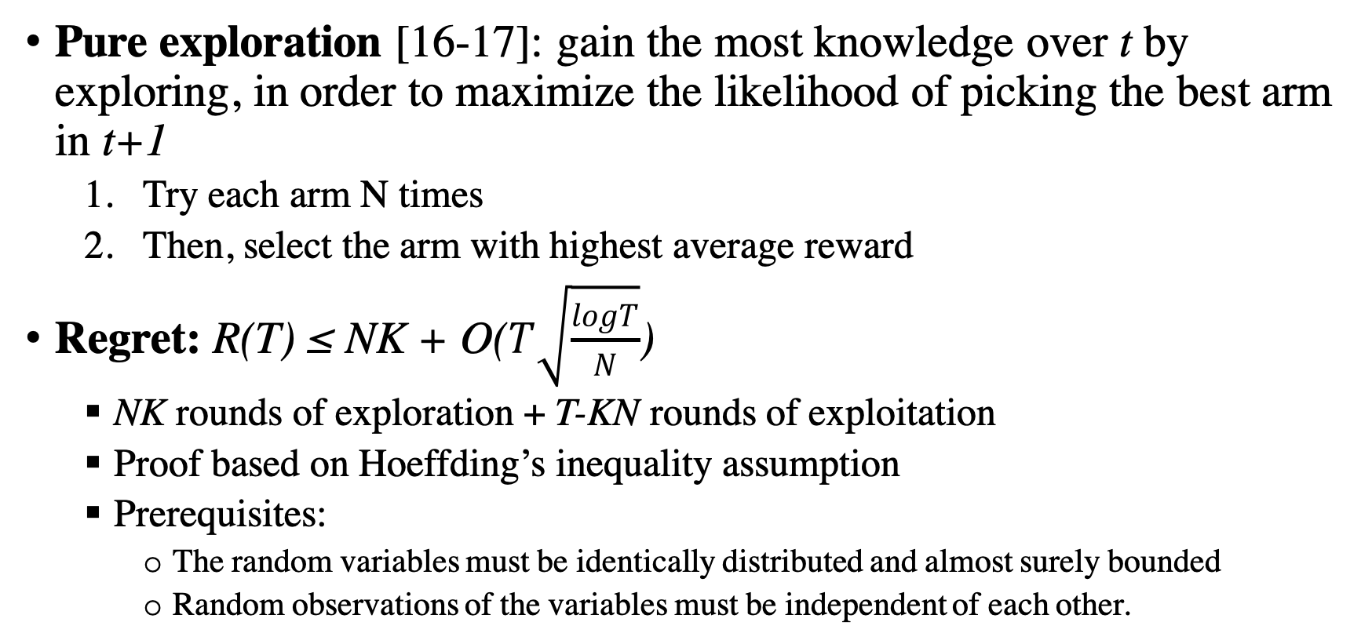
Pure exploration
Pure exploration [16-17]: gain the most knowledge over t by exploring, in order to maximize the likelihood of picking the best arm in t+1
Try each arm N times
Then, select the arm with highest average reward
Regret: R(T) ≤ NK + O($T\sqrt{\frac{logT}{N}}$)
NK rounds of exploration + T-KN rounds of exploitation
Proof based on Hoeffding’s inequality assumption
Prerequisites:
The random variables must be identically distributed and almost surely bounded
Random observations of the variables must be independent of each other.

Slide 18
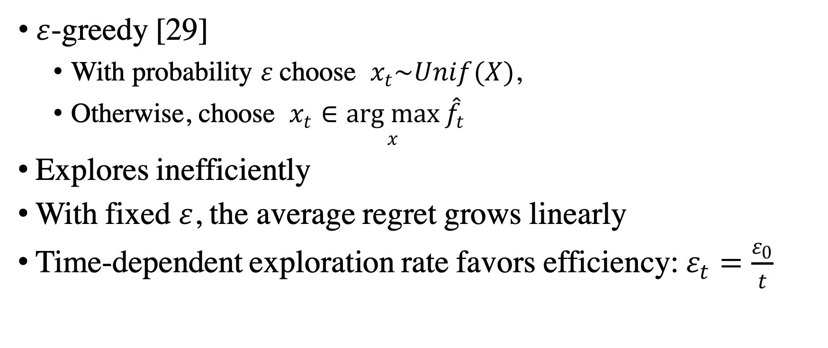
Greedy exploration
$ε$-greedy [29]
With probability $ε$choose $x_{t}\sim Unif(X)$,
Otherwise, choose $x_{t}∈\underset{x}{arg max}{{\hat{f}}_{t}}$
Explores inefficiently
With fixed $ε$, the average regret grows linearly
Time-dependent exploration rate favors efficiency: $ε_{t}=\frac{ε_{0}}{t}$

Slide 19
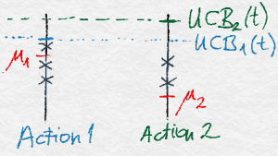
Optimistic methods
Upper Confidence Bound (UCB) [3, 28]
Assumes certain distributions for the rewards and picks the optimal arm accordingly
The action-selection process not only takes the magnitude of the reward into account, but the estimated deviations
Source: https://banditalgs.com/2016/09/18/the-upper-confidence-bound-algorithm/

Slide 20
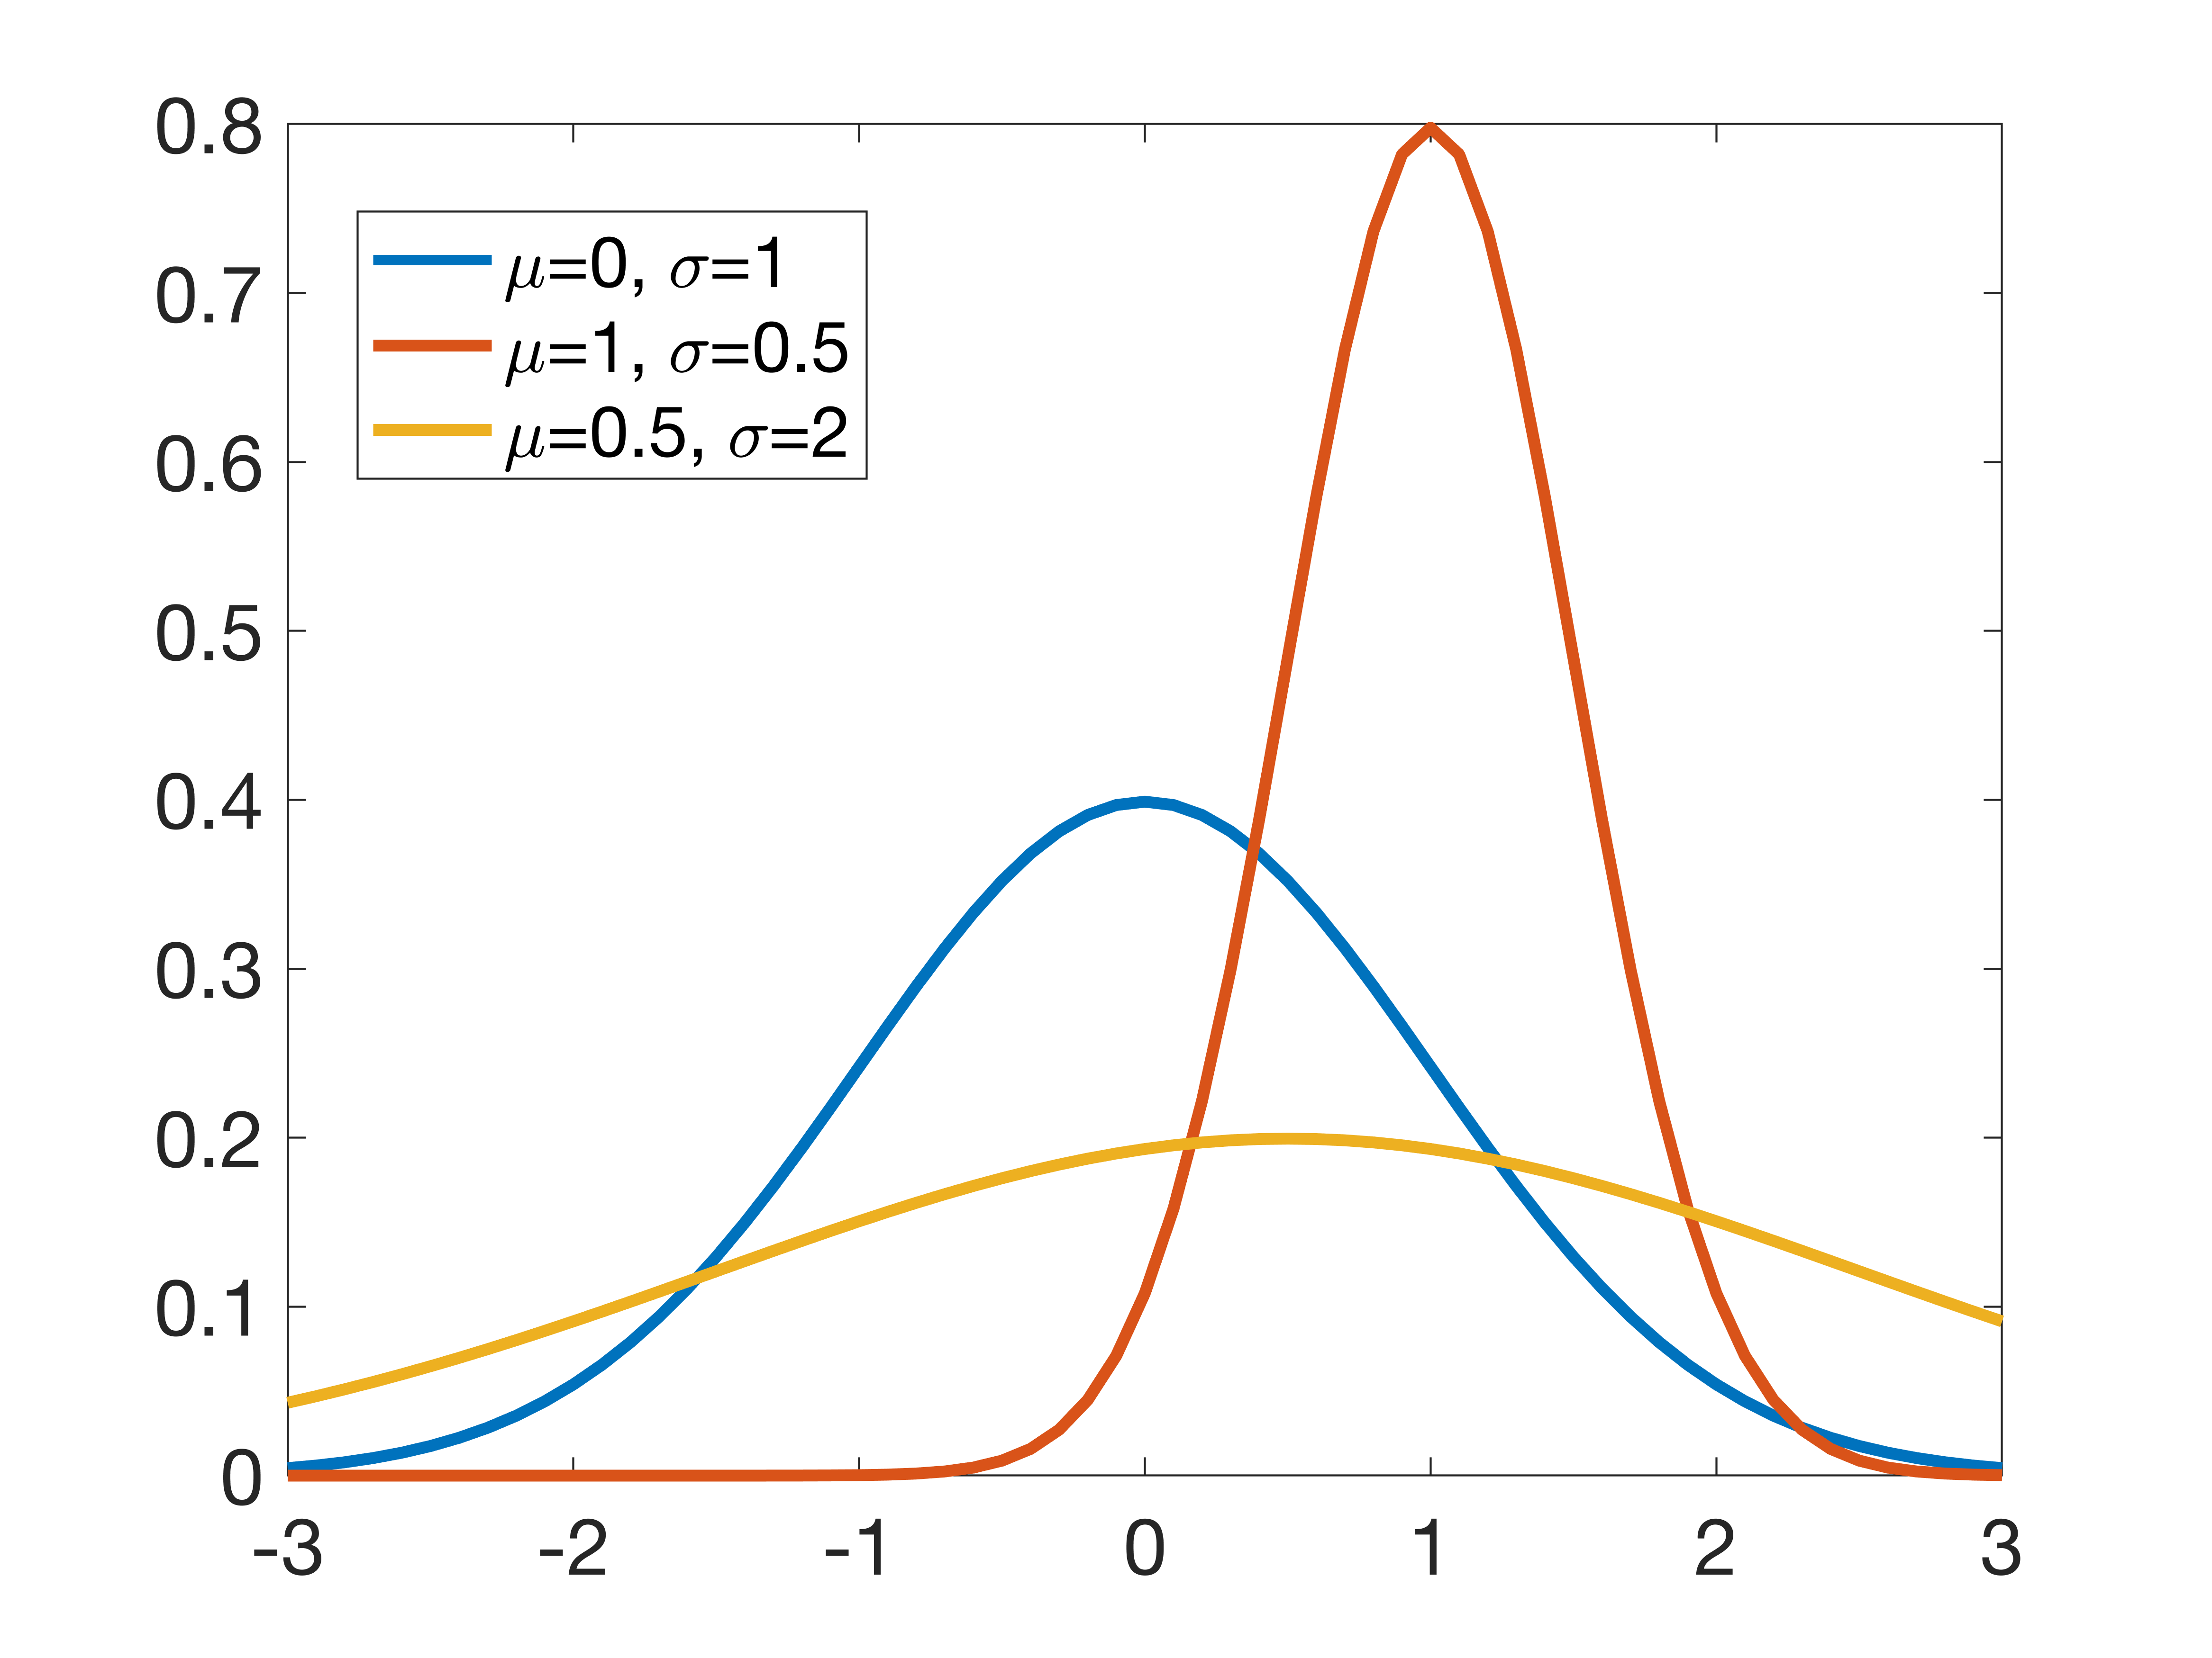
Bayesian methods
Thompson sampling [30]
Very popular because it is computationally cheap and offers good results
Strong performance guarantees [31, 32, 33]
Operational model:
Constructs a probabilistic model of the rewards and assumes a prior distribution of the parameters of said model
Then, it chooses the arm matching the probability of being optimal

Slide 21
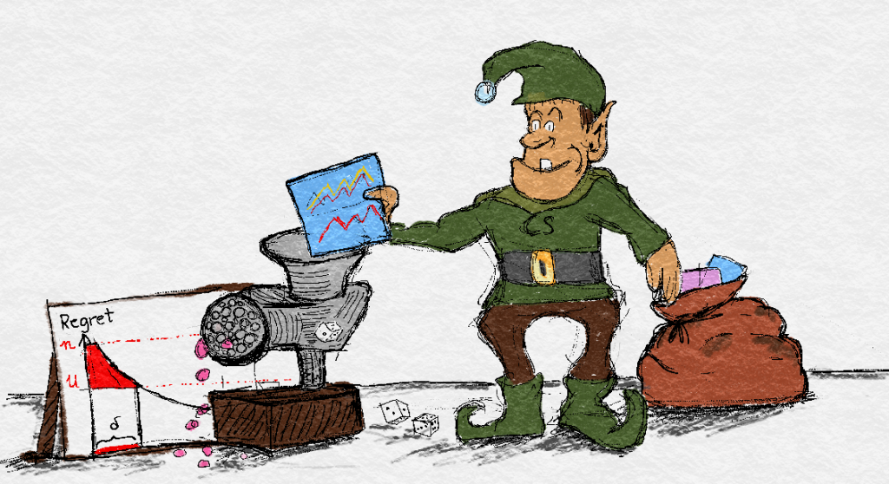
Minimax methods
Exponential-weight algorithm for Exploration and Exploitation (EXP3) [2]
Good for adversarial bandits
Make information advantage useless
Trade-off between randomizing and predicting
𝛾 regulates the desire to pick an action uniformly at random
Source: https://banditalgs.com/2016/10/14/high-probability-lower-bounds/
“The goal is to partially neutralize God’s information advantage, but adding sufficient determinism so that the bandit can still predict the superior arm most of the time.”
Source: https://www.chrisstucchio.com/blog/2014/adversarial_bandit_is_not_statistics_problem.html

Slide 22
Single-Agent vs Multi-Agent MABs

Slide 23
Single-Agent vs Multi-Agent MABs
SA-MAB: mainly concerned on sequential online decision making problem in an unknown environment
MA-MAB: where Game Theory and MABs meet and complement each other (competition between agents)

Slide 24
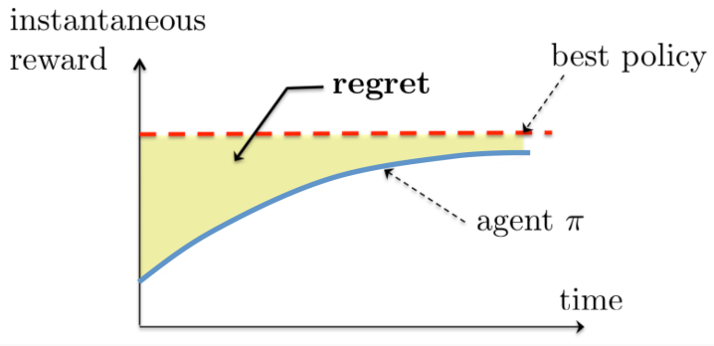
Single-Agent MABs
Baseline: [19, 20]
Properties:
Stationarity of the environment
Pure exploration-exploitation
The Regret measurement is completely meaningful in this setting
State-of-the-Art performance bounds:
Lai and Robbins, 1985
Anantharam et al., 1987 (multiple plays)

Slide 25
Multi-Agent MABs
Baseline: [53][54][55]
Many types: collaboration, opponent-aware, best-response…
Benefits:
Reduced complexity
Parallel computation
Scalability
Resilience (multi-point failure)
Drawbacks:
Non-stationarity
Hard to specify a goal
Exploitation leads to instability
Coordination often required

Slide 26

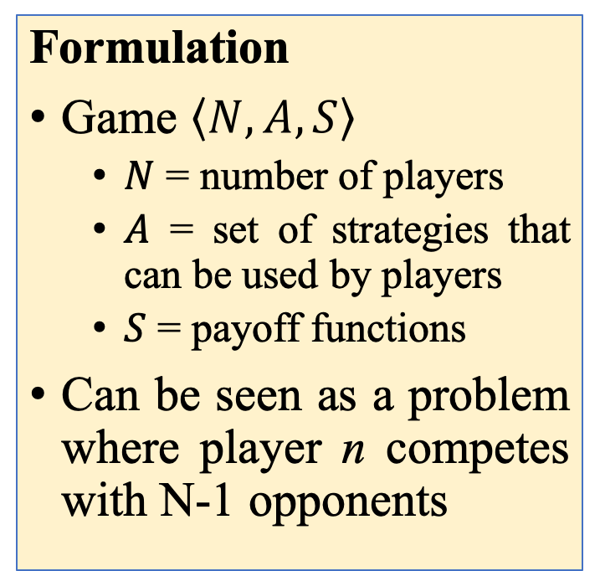
Multi-Agent MABs: Nexus with Game Theory
Ideal strategy:
Reach a NE
The utility of all the players is maximized
Formulation
Game $\left\langle N,A,S\right\rangle$
$N$ = number of players
$A$ = set of strategies that can be used by players
$S$ = payoff functions
Can be seen as a problem where player n competes with N-1 opponents
Problem:
Correlated Equilibrium: agents’ strategies eventually converge to a coordinated equilibrium

Slide 27
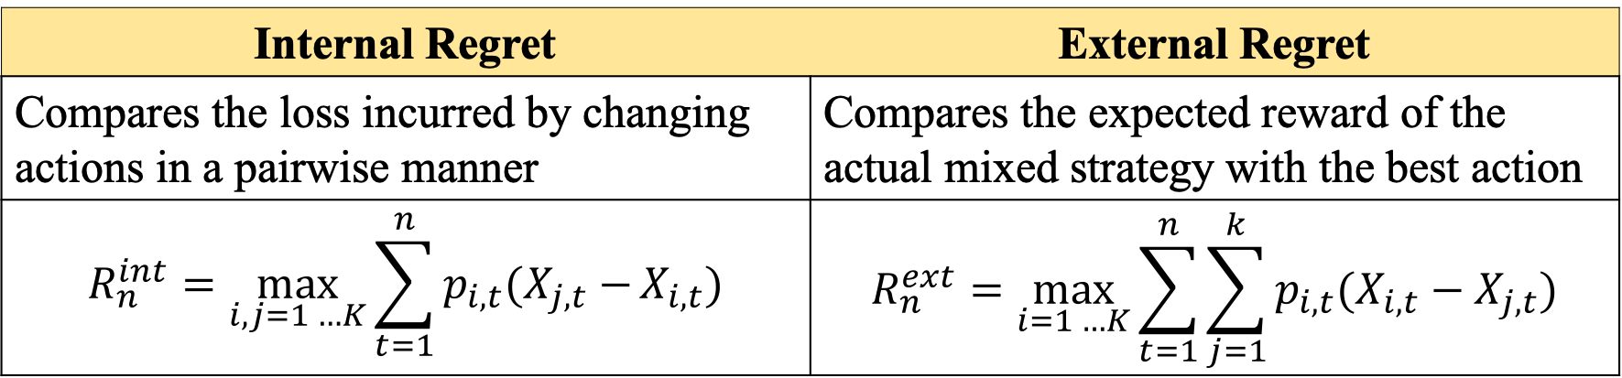
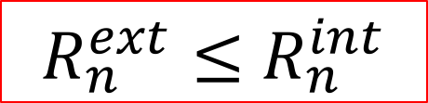
Internal and External regret
Internal Regret | External Regret
Compares the loss incurred by changing actions in a pairwise manner | Compares the expected reward of the actual mixed strategy with the best action
$$R_{n}^{int}=\max_{i,j=1 …K}{\sum_{t=1}^{n}{p_{i,t}(X_{j,t}−}}X_{i,t})$$ | $$R_{n}^{ext}=\max_{i=1 …K}{\sum_{t=1}^{n}{\sum_{j=1}^{k}{p_{i,t}(X_{i,t}−X_{j,t})}}}$$
Convergence to CE
Convergence to NE*
$R_{n}^{ext}≤$ $R_{n}^{int}$
*Only 2 players in a zero-sum game!

Slide 28
External-regret minimizing Algorithms
Weighted Average Prediction (WAP)
Hedge [4], variant of [21] for full information games
EXP3 [2]
Following the Perturbed Leader (FPL) [22], an online learning extension of [23]
Implicitly Normalized Forecaster (INF) Algorithm [24, 25]
Internal-Regret Minimizing Algorithm [26]

Slide 29
Internal-regret minimizing Algorithms
External-regret minimizing algorithms typically work only for N = 2 players
However, if every player uses an internal-regret minimizing strategy, the “joint empirical frequencies” of plays converge to a correlated equilibrium
The Experimental Regret Testing (ERT) [27] has been shown to exhibit internal-regret minimization

Slide 30
Bandits in Wireless Communications

Slide 31
Literature

Slide 32
MABs in Wireless Communications
MP-MABs for Opportunistic Spectrum Access [34-38]
Joint Channel Selection and Power Control in Cognitive Radio Networks [39]
Distributed inter-cell interference coordination [40]
Distributed user association in small cell networks [41]
Multi-path routing [42]
Dynamic rate and channel selection [43]
Unlicensed LTE/WiFi Coexistence [44]

Slide 33
MP-MABs in Cognitive Radio problems
Cognitive Radio problems have raised attention, due to its distributed nature
MP-MABs setting have been shown to properly fit to CR problems
Several efforts have been done to provide mechanisms whereby multiple users converge to the optimal solution
Baseline [45]
Combinatorial approach [46, 47]
TDFS approach [48]
User-specific penalties [39]
Calibrated Forecasting [37]

Slide 34
Typical setting for MP-MABs for CR
N agents use the same “bandit” (channel)
Centralized reward
The reward is binary
0: success
1: collision
Convergence can be provided if agents use the same strategy
E.g., “follow the perturbed leader” [39]

Slide 35
A more realistic setting
N agents use different “bandits” (e.g., transmission power levels)
The reward depends on the joint action profile
Non-stochastic setting
No guarantees

Slide 36
Typical Assumptions
Remarkable guarantees (convergence, performance, etc.) are often achieved only if certain assumptions hold:
Assumption | Drawbacks
All the players use the same strategy | Not feasible in dense and heterogeneous scenarios
The number of users is fixed and known | While the former implies that the network remains static, the latter entails communication or additional hardware
User-specific penalties are applied | A strong knowledge on the scenario must be known on before-hand
The reward generation process is relaxed and only depends on the own actions | Unfeasible in potentially overlapping scenarios, where the outer interference severely affects to the performance of a given WN

Slide 37
Use Case – Learning in Overlapping Basic Service Sets

Slide 38
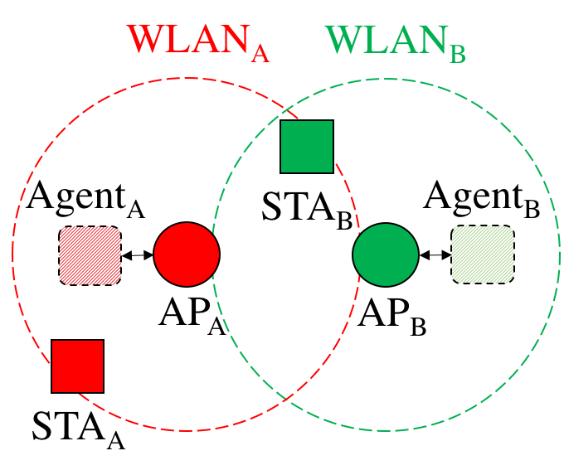
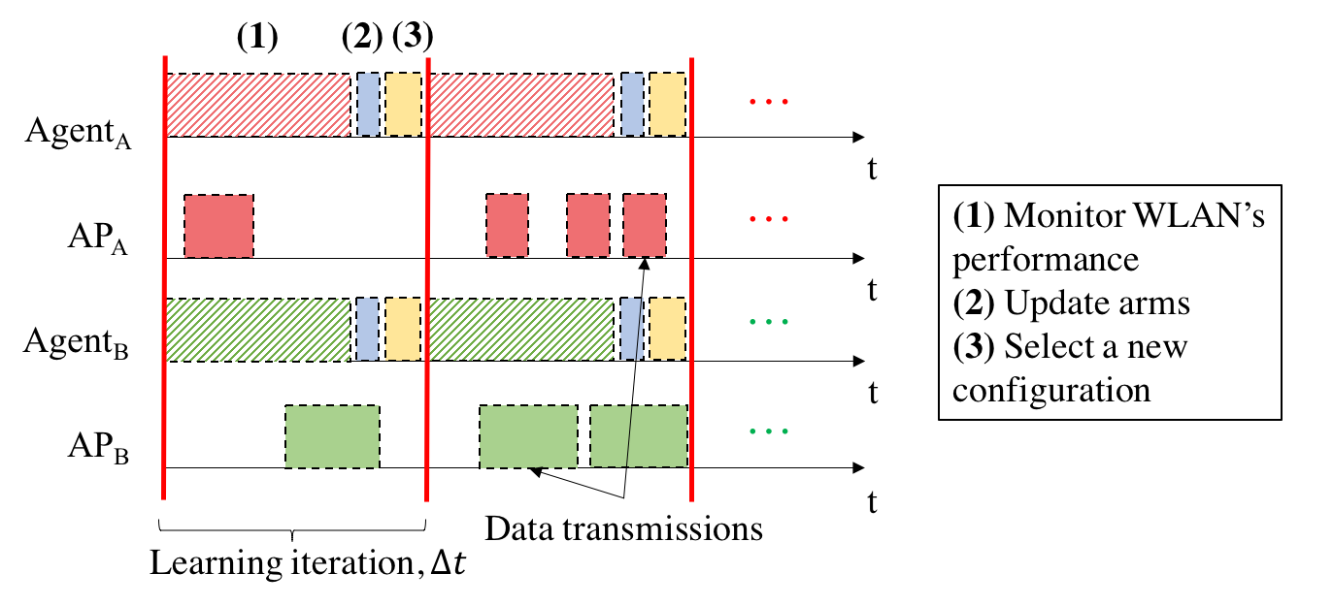
Integration of Agents

Slide 39
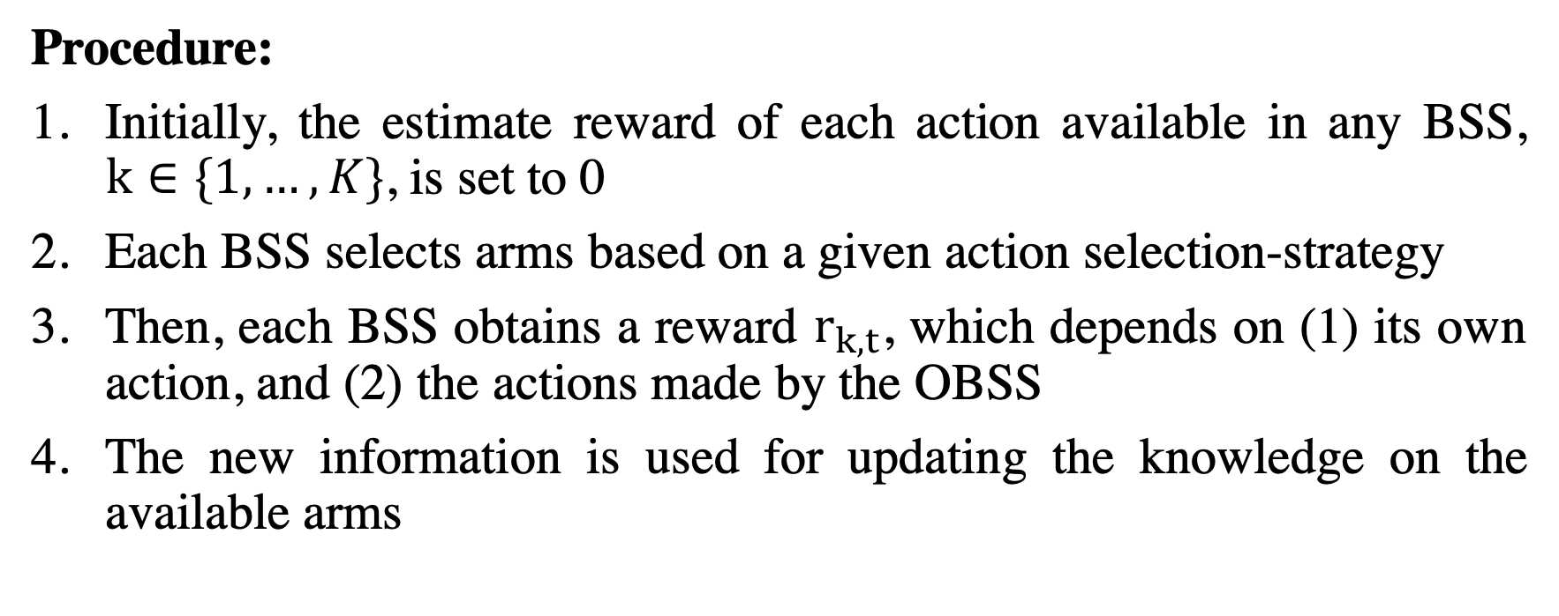
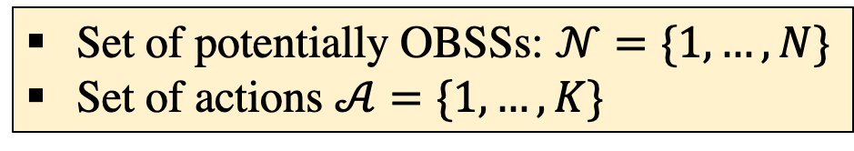
MABs formulation
Set of potentially OBSSs: $𝒩=\{1, …, N\}$
Set of actions $𝒜=\{1, …, K\}$
Procedure:
Initially, the estimate reward of each action available in any BSS, $k∈\{1, …, K\}$, is set to 0
Each BSS selects arms based on a given action selection-strategy
Then, each BSS obtains a reward $r_{k,t}$, which depends on (1) its own action, and (2) the actions made by the OBSS
The new information is used for updating the knowledge on the available arms

Slide 40
Reward definition (I)
The reward is generated after a BSS (or a set of BSSs) makes an action
It may be “selfish” or “collaborative”, according to the performance measure considered
The reward quantifies the performance experienced by the BSS
Examples:
Throughput
Packets acknowledged vs packets sent
Maximum delay
Total interference
…

Slide 41
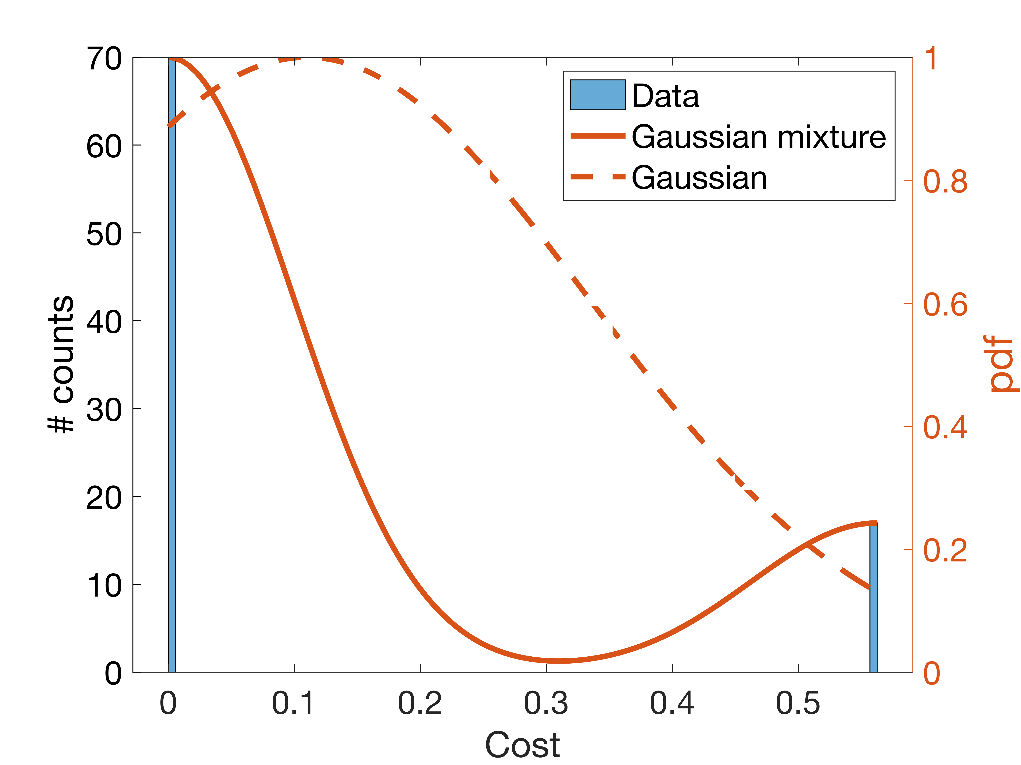
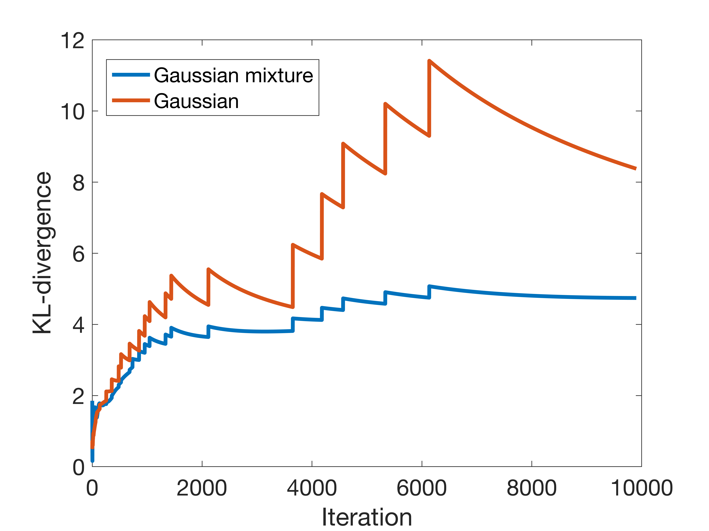
Reward definition (II)
Typically, rewards are assumed to be generated from well-known distributions (e.g., Gaussian)
Not true in reality (worsened for multi-player settings)
Then, performance guarantees cannot be ensured
Good results have been shown on assuming Gaussian distribution for the SR problem [49, 50]
Notes:
Allow to rapidly track best/worst distributions, but more subtle interactions cannot be identified and are easily missed.

Slide 42
Reward normalization
Normalize the reward for the sake of algorithms’ stability
The optimal performance may be unknown
Provide reasonable upper bounds:
Maximum achievable data rate
Theoretical capacity
Minimum requirement
…

Slide 43
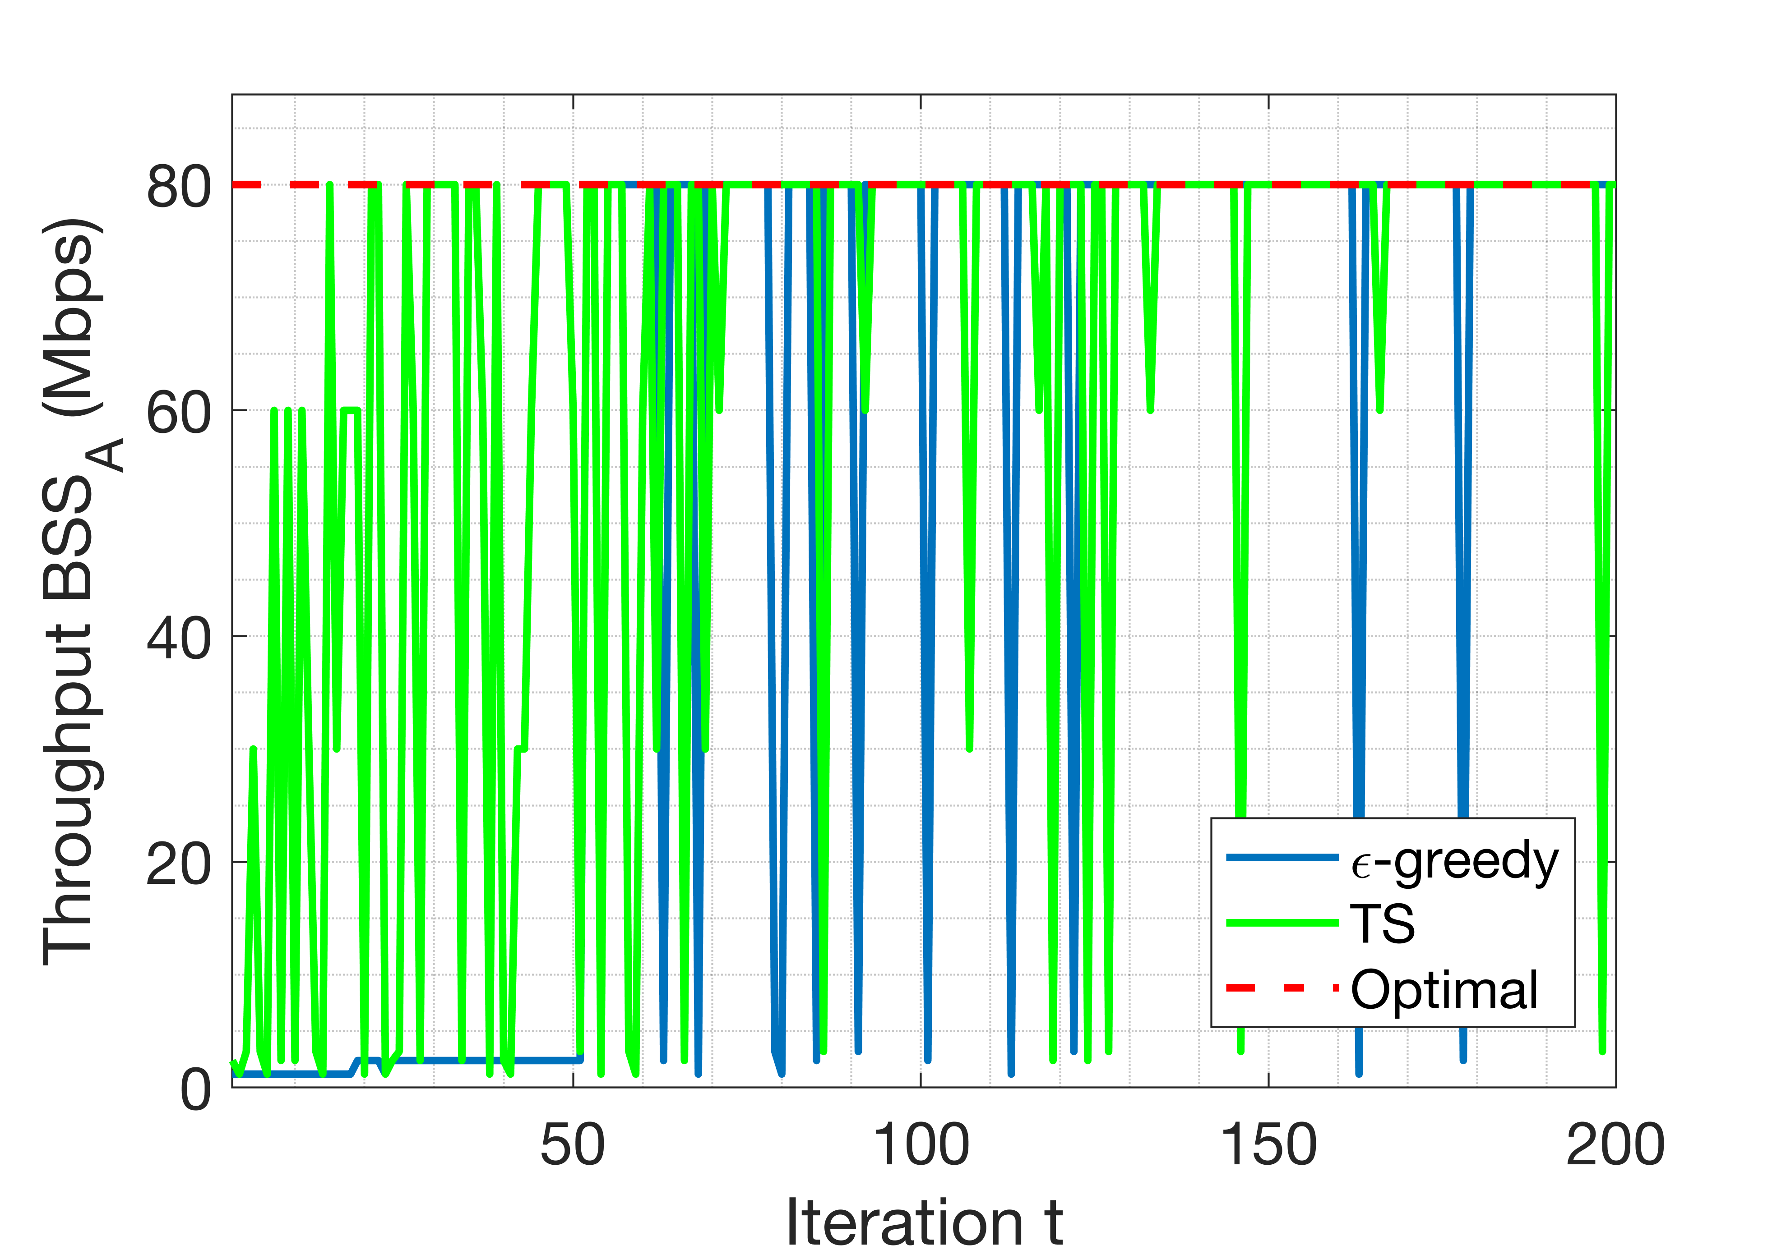
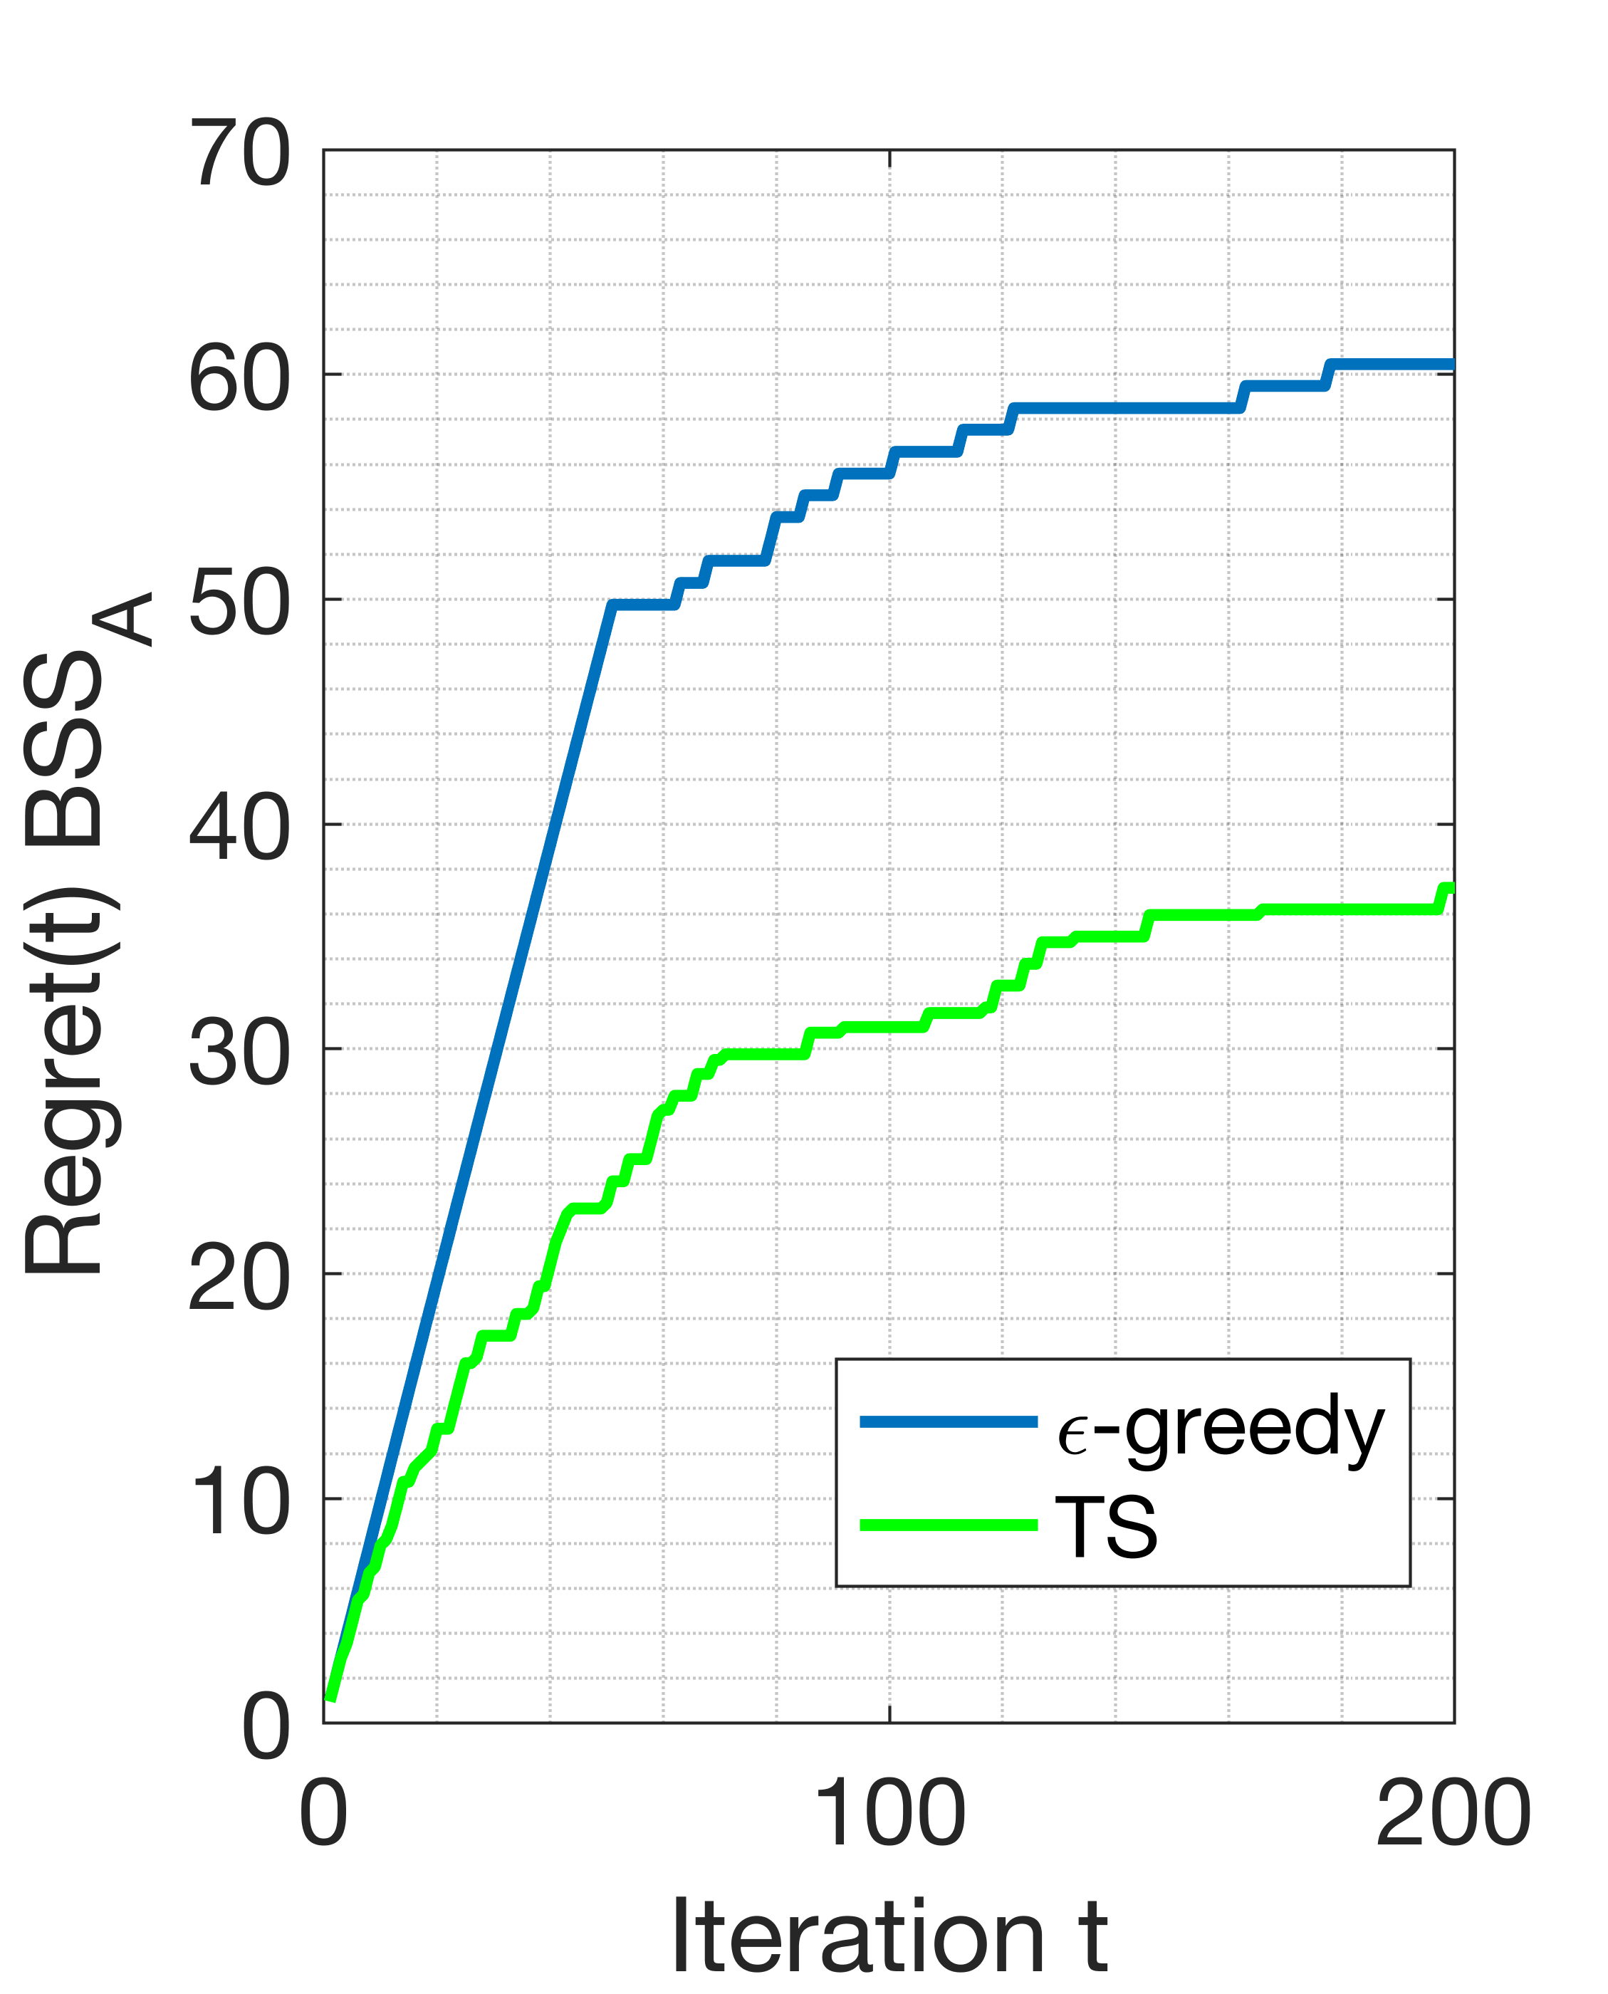
Deployment:
Single-Agent SR
Active
Passive

Slide 44
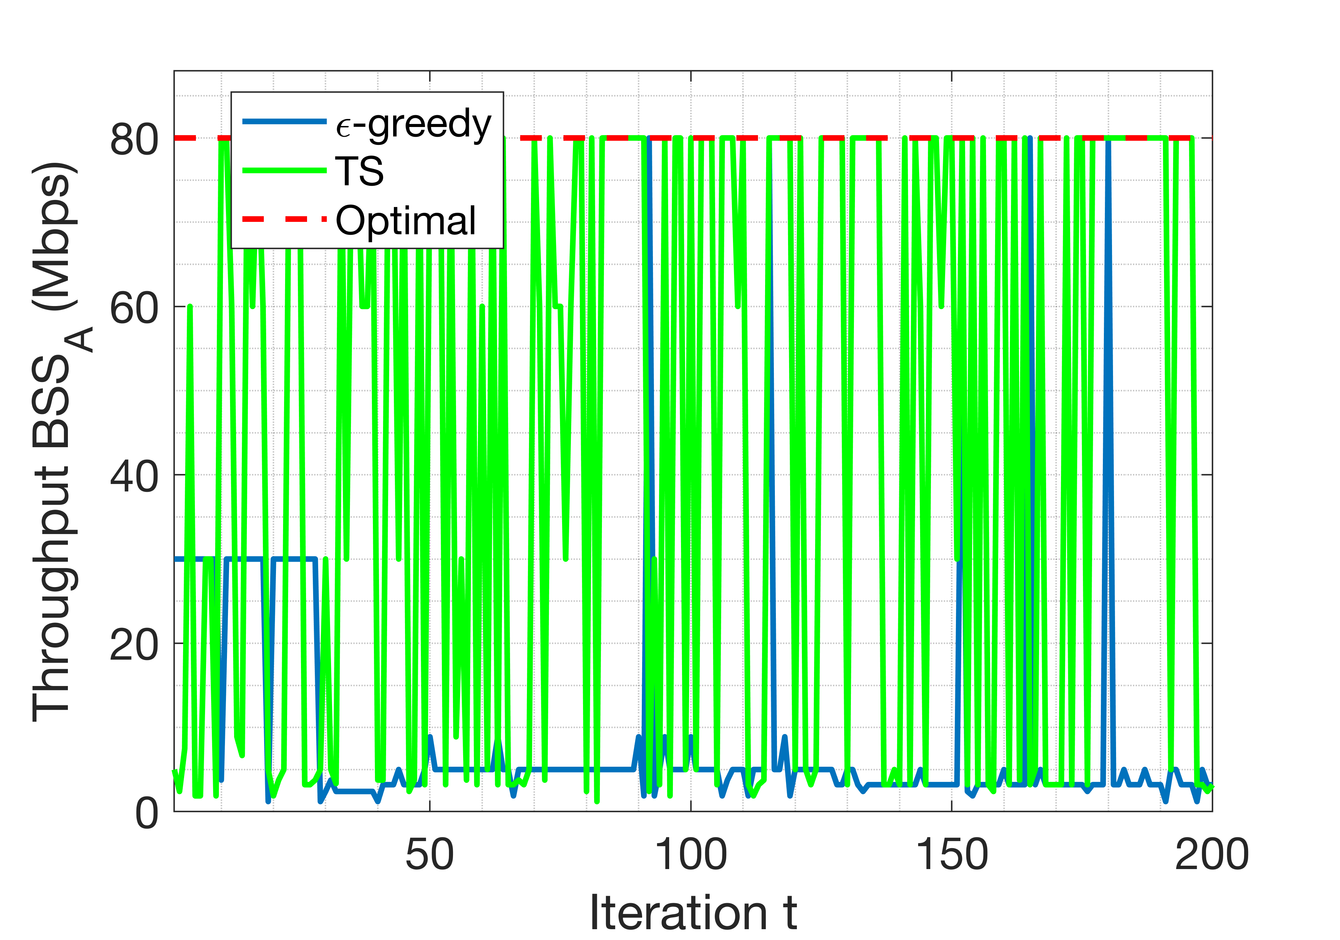
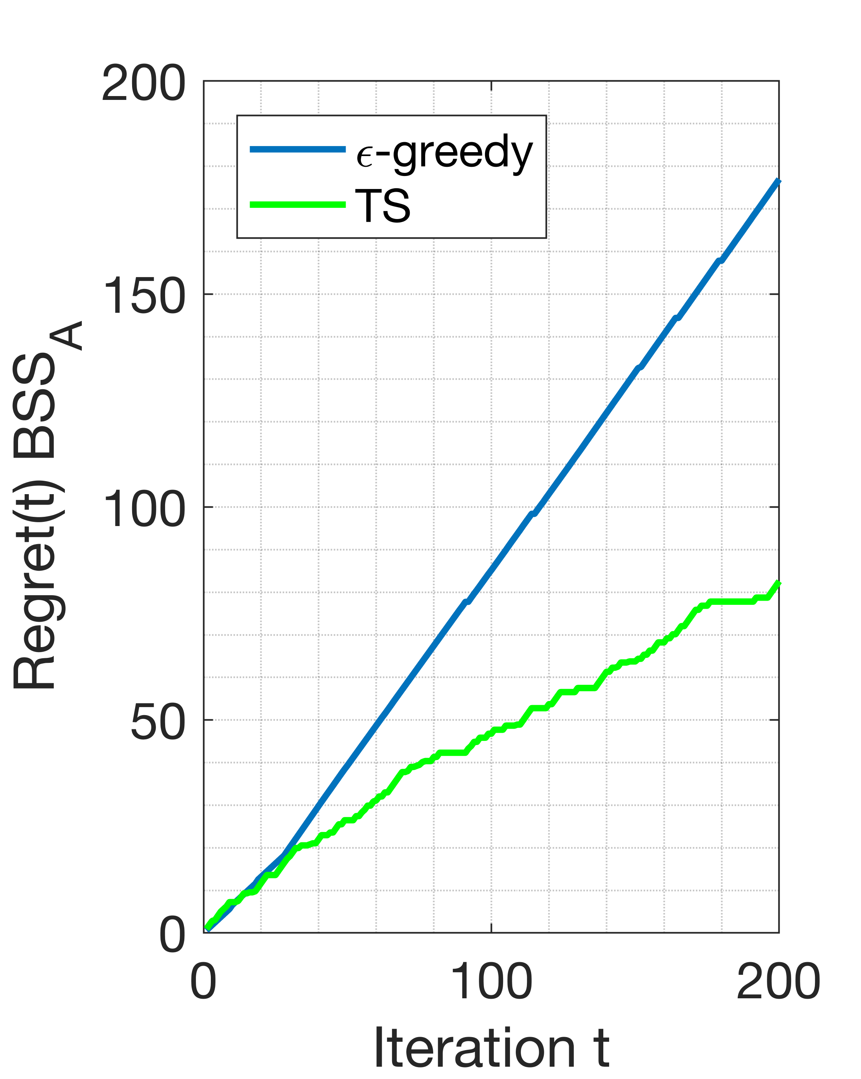
Deployment:
Multi-Agent SR
Active
Passive

Slide 45
Multi-Player Spatial Reuse

Slide 46

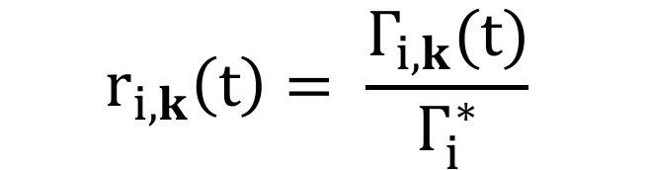
Selfish approach
Selfish reward:
$$r_{i,k}\left(t\right)= \frac{Γ_{i,k}(t)}{Γ_{i}^{∗}}$$
Selfish metric
(throughput)

Slide 47

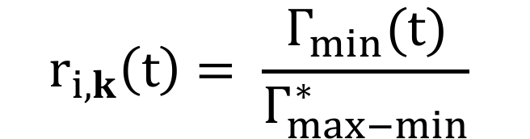
Collaborative approach
Collaborative reward:
$$r_{i,k}\left(t\right)= \frac{Γ_{min}(t)}{Γ_{max−min}^{∗}}$$
Shared metric
(minimum throughput)

Slide 48
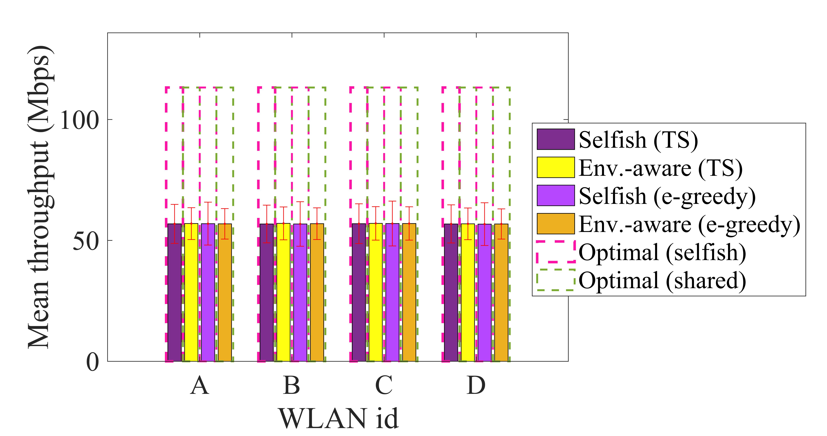
Results selfish and collaborative settings
Selfishness is counter-productive
Can also lead to unfairness
The shared metric does not solve the problem neither
Source: [50]

Slide 49
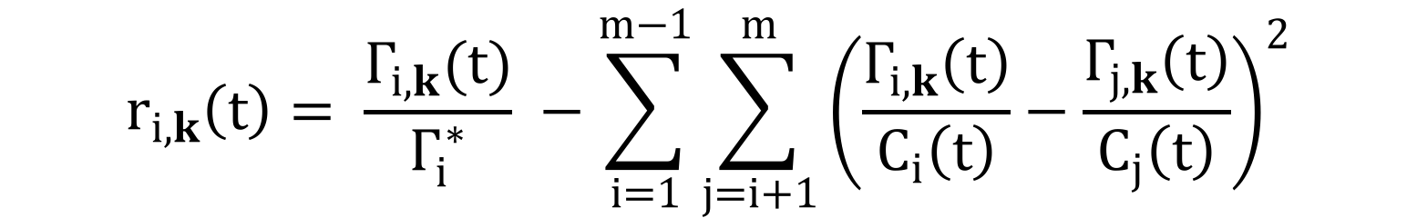
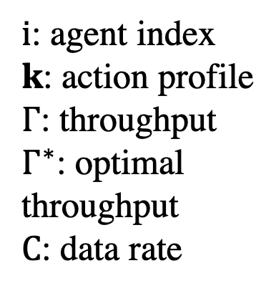
Trying to reach an equilibrium
Reward composed by two parts:
$$r_{i,k}\left(t\right)= \frac{Γ_{i,k}(t)}{Γ_{i}^{∗}} −\sum_{i=1}^{m−1}{\sum_{j=i+1}^{m}{{\left(\frac{Γ_{i,k}\left(t\right)}{C_{i}\left(t\right)}−\frac{Γ_{j,k}\left(t\right)}{C_{j}\left(t\right)}\right)}^{2}}}$$
$i$: agent index
$k$: action profile
$Γ$: throughput
$Γ^{∗}$: optimal throughput
$C$: data rate
Selfish metric
(throughput)
Fairness metric (cost)

Slide 50
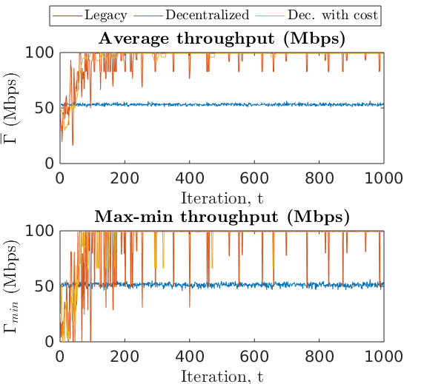
Preliminary results (I)

Slide 51
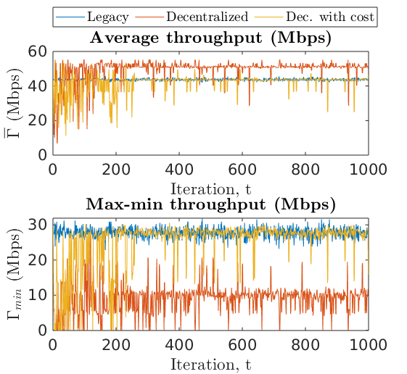
Preliminary results (II)

Slide 52
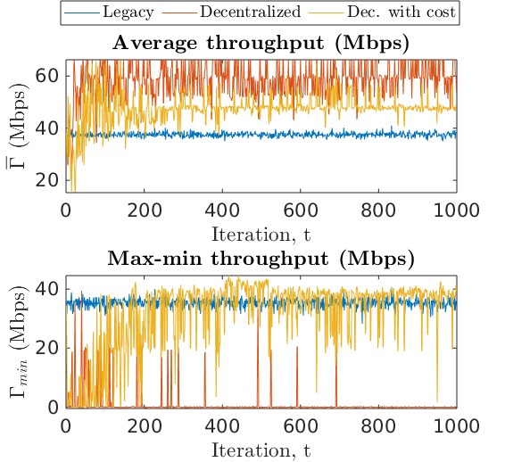
Preliminary results (III)

Slide 53
Some Conclusions

Slide 54
Some Conclusions
The learning process in wireless networks can be really slow
We need to question ourselves: is it worth?
Convergence guarantees may not exist, neither logarithmic regret decreasing
Decentralized/Distributed settings are, in practice, unfeasible due to non-stationarity
However, performance maximization can be provided
Feasibility of applying learning in wireless networks
Distributed (message exchanging / inference)
Centralized system

Slide 55
References
[1] Katehakis, M. N., & Veinott Jr, A. F. (1987). The multi-armed bandit problem: decomposition and computation. Mathematics of Operations Research, 12(2), 262-268.
[2] Gittins, J., Glazebrook, K., & Weber, R. (2011). Multi-armed bandit allocation indices. John Wiley & Sons.
[3] Auer, P., Cesa-Bianchi, N., & Fischer, P. (2002). Finite-time analysis of the multiarmed bandit problem. Machine learning, 47(2-3), 235-256.
[4] Auer, P., Cesa-Bianchi, N., Freund, Y., & Schapire, R. E. (1995, October). Gambling in a rigged casino: The adversarial multi-armed bandit problem. In Foundations of Computer Science, 1995. Proceedings., 36th Annual Symposium on (pp. 322-331). IEEE.
[5] Bubeck, S., & Cesa-Bianchi, N. (2012). Regret analysis of stochastic and nonstochastic multi-armed bandit problems. Foundations and Trends® in Machine Learning, 5(1), 1-122.
[6] Vermorel, J., & Mohri, M. (2005, October). Multi-armed bandit algorithms and empirical evaluation. In European conference on machine learning (pp. 437-448). Springer, Berlin, Heidelberg.
[7] Auer, Peter, et al. "The nonstochastic multiarmed bandit problem." SIAM journal on computing 32.1 (2002): 48-77.
[8] Slivkins, A. (2014). Contextual bandits with similarity information. Journal of Machine Learning Research, 15(1), 2533-2568.

Slide 56
References
[9] Agrawal, S., & Goyal, N. (2013, February). Thompson sampling for contextual bandits with linear payoffs. In International Conference on Machine Learning (pp. 127-135).
[10] Cesa-Bianchi, N., & Lugosi, G. (2012). Combinatorial bandits. Journal of Computer and System Sciences, 78(5), 1404-1422.
[11] Chen, W., Wang, Y., & Yuan, Y. (2013, February). Combinatorial multi-armed bandit: General framework and applications. In International Conference on Machine Learning (pp. 151-159).
[12] Chakrabarti, D., Kumar, R., Radlinski, F., & Upfal, E. (2009). Mortal multi-armed bandits. In Advances in neural information processing systems (pp. 273-280).
[13] Anantharam, V., Varaiya, P., & Walrand, J. (1987). Asymptotically efficient allocation rules for the multiarmed bandit problem with multiple plays-Part I: IID rewards. IEEE Transactions on Automatic Control, 32(11), 968-976.
[14] Anantharam, V., Varaiya, P., & Walrand, J. (1987). Asymptotically efficient allocation rules for the multiarmed bandit problem with multiple plays-Part II: Markovian rewards. IEEE Transactions on Automatic Control, 32(11), 977-982.
[15] Komiyama, J., Honda, J., & Nakagawa, H. (2015). Optimal regret analysis of thompson sampling in stochastic multi-armed bandit problem with multiple plays. arXiv preprint arXiv:1506.00779.

Slide 57
References
[16] Bubeck, S., Munos, R., & Stoltz, G. (2011). Pure exploration in finitely-armed and continuous-armed bandits. Theoretical Computer Science, 412(19), 1832-1852.
[17] Chen, S., Lin, T., King, I., Lyu, M. R., & Chen, W. (2014). Combinatorial pure exploration of multi-armed bandits. In Advances in Neural Information Processing Systems (pp. 379-387).
[18] Yue, Y., Broder, J., Kleinberg, R., & Joachims, T. (2012). The k-armed dueling bandits problem. Journal of Computer and System Sciences, 78(5), 1538-1556.
[19] Robbins, H. (1985). Some aspects of the sequential design of experiments. In Herbert Robbins Selected Papers (pp. 169-177). Springer, New York, NY.
[20] Thompson, W. R. (1933). On the likelihood that one unknown probability exceeds another in view of the evidence of two samples. Biometrika, 25(3/4), 285-294.
[21] Littlestone, N., & Warmuth, M. K. (1994). The weighted majority algorithm. Information and computation, 108(2), 212-261.
[22] Kujala, J., & Elomaa, T. (2007, October). Following the perturbed leader to gamble at multi-armed bandits. In International Conference on Algorithmic Learning Theory (pp. 166-180). Springer, Berlin, Heidelberg.
[23] Hannan, J. (1957). Approximation to Bayes risk in repeated play. Contributions to the Theory of Games, 3, 97-139.

Slide 58
References
[24] Audibert, J. Y., & Bubeck, S. (2009, June). Minimax policies for adversarial and stochastic bandits. In COLT (pp. 217-226).
[25] Audibert, J. Y., & Bubeck, S. (2010). Regret bounds and minimax policies under partial monitoring. Journal of Machine Learning Research, 11(Oct), 2785-2836.
[26] Stoltz, G., & Lugosi, G. (2005). Internal regret in on-line portfolio selection. Machine Learning, 59(1-2), 125-159.
[27] Cesa-Bianchi, N., & Lugosi, G. (2006). Prediction, learning, and games. Cambridge university press.
[28] Agrawal, R. (1995). Sample mean based index policies by o (log n) regret for the multi-armed bandit problem. Advances in Applied Probability, 27(4), 1054-1078.
[29] Sutton, R. S., & Barto, A. G. (1998). Reinforcement learning: An introduction (Vol. 1, No. 1). Cambridge: MIT press.
[30] William R Thompson. On the likelihood that one unknown probability exceeds another in view of the evidence of two samples. Biometrika, 25(3/4):285–294, 1933.
[31] Shipra Agrawal and Navin Goyal. Analysis of thompson sampling for the multi-armed bandit problem. In Conference on Learning Theory, pages 39–1, 2012.

Slide 59
References
[32] Emilie Kaufmann, Nathaniel Korda, and R´emi Munos. Thompson sampling: An asymptotically optimal finite time analysis. In Algorithmic Learning Theory, pages 199–213. Springer, 2012.
[33] Nathaniel Korda, Emilie Kaufmann, and Remi Munos. Thompson sampling for 1- dimensional exponential family bandits. In C. J. C. Burges, L. Bottou, M. Welling, Z. Ghahramani, and K. Q. Weinberger, editors, Advances in Neural Information Processing Systems 26, pages 1448–1456. Curran Associates, Inc., 2013.
[34] Keqin Liu and Qing Zhao. Distributed learning in multi-armed bandit with multiple players. IEEE Transactions on Signal Processing, 58(11):5667–5681, 2010.
[35] Animashree Anandkumar, Nithin Michael, Ao Kevin Tang, and Ananthram Swami. Distributed algorithms for learning and cognitive medium access with logarithmic regret. IEEE Journal on Selected Areas in Communications, 29(4):731–745, 2011.
[36] Jonathan Rosenski, Ohad Shamir, and Liran Szlak. Multi-player bandits–a musical chairs approach. In International Conference on Machine Learning, pages 155–163, 2016.
[37] Setareh Maghsudi and Slawomir Stanczak. Channel selection for network-assisted D2D communication via no-regret bandit learning with calibrated forecasting. IEEE Transactions on Wireless Communications, 14(3):1309–1322, 2015.

Slide 60
References
[38] Di Felice, M., Chowdhury, K. R., & Bononi, L. (2011, December). Learning with the bandit: A cooperative spectrum selection scheme for cognitive radio networks. In Global Telecommunications Conference (GLOBECOM 2011), 2011 IEEE (pp. 1-6). IEEE.
[39] Setareh Maghsudi and Slawomir Stanczak. Joint channel selection and power control in infrastructureless wireless networks: A multiplayer multiarmed bandit framework. IEEE Transactions on Vehicular Technology, 64(10):4565–4578, 2015.
[40] Coucheney, P., Khawam, K., & Cohen, J. (2015, June). Multi-Armed Bandit for distributed Inter-Cell Interference Coordination. In ICC (pp. 3323-3328).
[41] Maghsudi, S., & Hossain, E. (2017). Distributed user association in energy harvesting dense small cell networks: A mean-field multi-armed bandit approach. IEEE Access, 5, 3513-3523.
[42] Henri, S., Vlachou, C., & Thiran, P. (2018) Multi-armed Bandit in Action: Optimizing Performance in Dynamic Hybrid Networks.
[43] Combes, R., & Proutiere, A. (2015). Dynamic rate and channel selection in cognitive radio systems. IEEE Journal on Selected Areas in Communications, 33(5), 910-921.
[44] Cano, C., & Neu, G. (2018). Wireless Optimisation via Convex Bandits: Unlicensed LTE/WiFi Coexistence. arXiv preprint arXiv:1802.04327.

Slide 61
References
[45] Anandkumar, A., Michael, N., Tang, A. K., & Swami, A. (2011). Distributed algorithms for learning and cognitive medium access with logarithmic regret. IEEE Journal on Selected Areas in Communications, 29(4), 731-745.
[46] Gai, Y., Krishnamachari, B., & Jain, R. (2010, April). Learning multiuser channel allocations in cognitive radio networks: A combinatorial multi-armed bandit formulation. In New Frontiers in Dynamic Spectrum, 2010 IEEE Symposium on (pp. 1-9). IEEE.
[47] Gai, Y., Krishnamachari, B., & Jain, R. (2012). Combinatorial network optimization with unknown variables: Multi-armed bandits with linear rewards and individual observations. IEEE/ACM Transactions on Networking (TON), 20(5), 1466-1478.
[48] Liu, K., & Zhao, Q. (2010). Distributed learning in multi-armed bandit with multiple players. IEEE Transactions on Signal Processing, 58(11), 5667-5681.
[49] Wilhelmi, F., Cano, C., Neu, G., Bellalta, B., Jonsson, A., & Barrachina-Muñoz, S. (2017). Collaborative Spatial Reuse in Wireless Networks via Selfish Multi-Armed Bandits. arXiv preprint arXiv:1710.11403.
[50] Wilhelmi, F., Barrachina-Muñoz, S., Cano, C., Bellalta, B., Jonsson, A., & Neu, G. (2018). Potential and Pitfalls of Multi-Armed Bandits for Decentralized Spatial Reuse in WLANs. arXiv preprint arXiv:1805.11083.

Slide 62
References
[51] Ortner, Ronald, et al. "Regret bounds for restless Markov bandits." International Conference on Algorithmic Learning Theory. Springer, Berlin, Heidelberg, 2012.
[52] Kleinberg, Robert, Alexandru Niculescu-Mizil, and Yogeshwer Sharma. "Regret bounds for sleeping experts and bandits." Machine learning 80.2-3 (2010): 245-272.
[52] Luo, Haipeng, et al. "Efficient contextual bandits in non-stationary worlds." arXiv preprint arXiv:1708.01799 (2017).
[53] Tan, Ming. "Multi-agent reinforcement learning: Independent vs. cooperative agents." Proceedings of the tenth international conference on machine learning. 1993.
[54] Littman, Michael L. "Markov games as a framework for multi-agent reinforcement learning." Machine learning proceedings 1994. Morgan Kaufmann, 1994. 157-163.
[55] Shahrampour, Shahin, Alexander Rakhlin, and Ali Jadbabaie. "Multi-armed bandits in multi-agent networks." 2017 IEEE International Conference on Acoustics, Speech and Signal Processing (ICASSP). IEEE, 2017.

